Slide 1
Dehumanizing Humanities: Thinking ourselves into the Being of Another “Clarksdale Mississippi”
Note: This is an academic manifesto written for Hypatia

Slide 2
This May I was in Clarksdale Mississippi:

Slide 3
Clarksdale Mississippi is a small town in the Yazoo-Mississippi Delta in the Northern American south
The story of the delta is the story of a certain phenomenon in the humanities. To bring this phenomenon to light I will take a detour from professional philosophy. I will take a detour, that is, from the language of *cool* and *philosophical* understanding that is available to me as a professional philosopher
I will instead talk about my being haunted by a small town in the Delta: Clarksdale Mississippi.
But in doing so I will take a detour from personal writing. I will take a detour, that is, from the *heated* and *personal* language that is available to me as a writer.

Slide 4
the asterix
is the mark of irony. This is not common irony about saying one thing and meaning another but Kierkegaard’s irony about being itself. This is the irony that for instance asks of *cool* and *philosophical*: “in the midst of all this coolness and philosophy, is there anything at all that is cool and philosophical”? The irony that asks of *heated* and *personal*: “In the midst of all this heat and personality, is there anything at all that is heated and personal?”

Slide 5
In this talk I will try to understand what it is for me to be haunted by Clarksdale Mississippi.
To do this I will be old-fashioned. I will follow the old method of the Humanities [the Sciences of the Spirit (GeistesWissenshaften)]: interpretation.
I will, that is, attempt to understand what it is for me to be haunted by Clarksdale Mississippi by trying to interpret a text; to understand what it is for a text to be itself.

Slide 6
The text
is the text of the distinguished Tanner Lectures on *Human Value*, in which a novelist (Jonathan Coetzee) presents one of the fictional characters of his novels (the novelist Elizabeth Costello) herself giving a set of distinguished academic lectures on the *Lives of Animals*.

Slide 7
But first, here is the story of the Delta: In 1830 and 1837 the white man *relocated* the black natives ( Choctaw and Chickasaw Nations) to Oklahoma. [“In the midst of all this relocation, was there any relocation?”] Soon after that the white man *established cotton plantations*. [“Among all the cotton plantations was there a plantation?”]After the *abolition of slavery* the liberated black remained in the plantations as *sharecroppers* [“Amidst all the abolitions of slavery was there an abolition? “Among the sharecroppers was there a sharecropper?”]. After the end of the civil war the state of Mississippi was the first to *legislate the Black Codes*[In the midst of these codes were there any codes?”] , which were the predecessors of the *Jim Crow laws* [Among all these laws was there a law?” (“separate but equal”), which disenfranchised the black populations and which continued in force until 1965. In the 60s the area was one of the sites of the civil rights movement. The industrialization of labor in the 40’s *drove black populations* [in the midt of all this driving was there any driving?”] to Chicago (the *Great Migration*), where the modern *urban ghetto* was first formulated through legislation which *effectively discourage* [In the midst of all this discouragement was there a discouragement?]black immigrants to rent property in most areas in Chicago. In 1954 the U.S. Supreme Court issued its landmark ruling on school segregation in Brown vs. Board Education. In May of 2016 I was in Clarksdale Mississippi again. In May 2016 the federal judge Debra M. Brown ordered the *desegregation*[In the midst of all that desegregation was there a desegregation?] of the school district of the area.
What is this phenomenon that we may thus mark in red with Kierkegaard’s irony?
What can we think about it? What can we think about my being haunted by Clarksdale Mississippi?

Slide 8
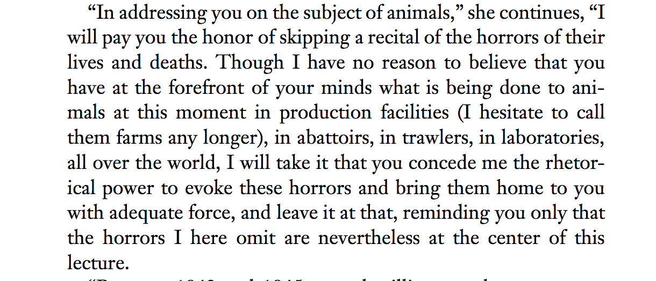
In the beginning of *the* Lectures on Human Value which is *her* Lectures on the Lives of Animals
Coetzee (he) writes:

Slide 12
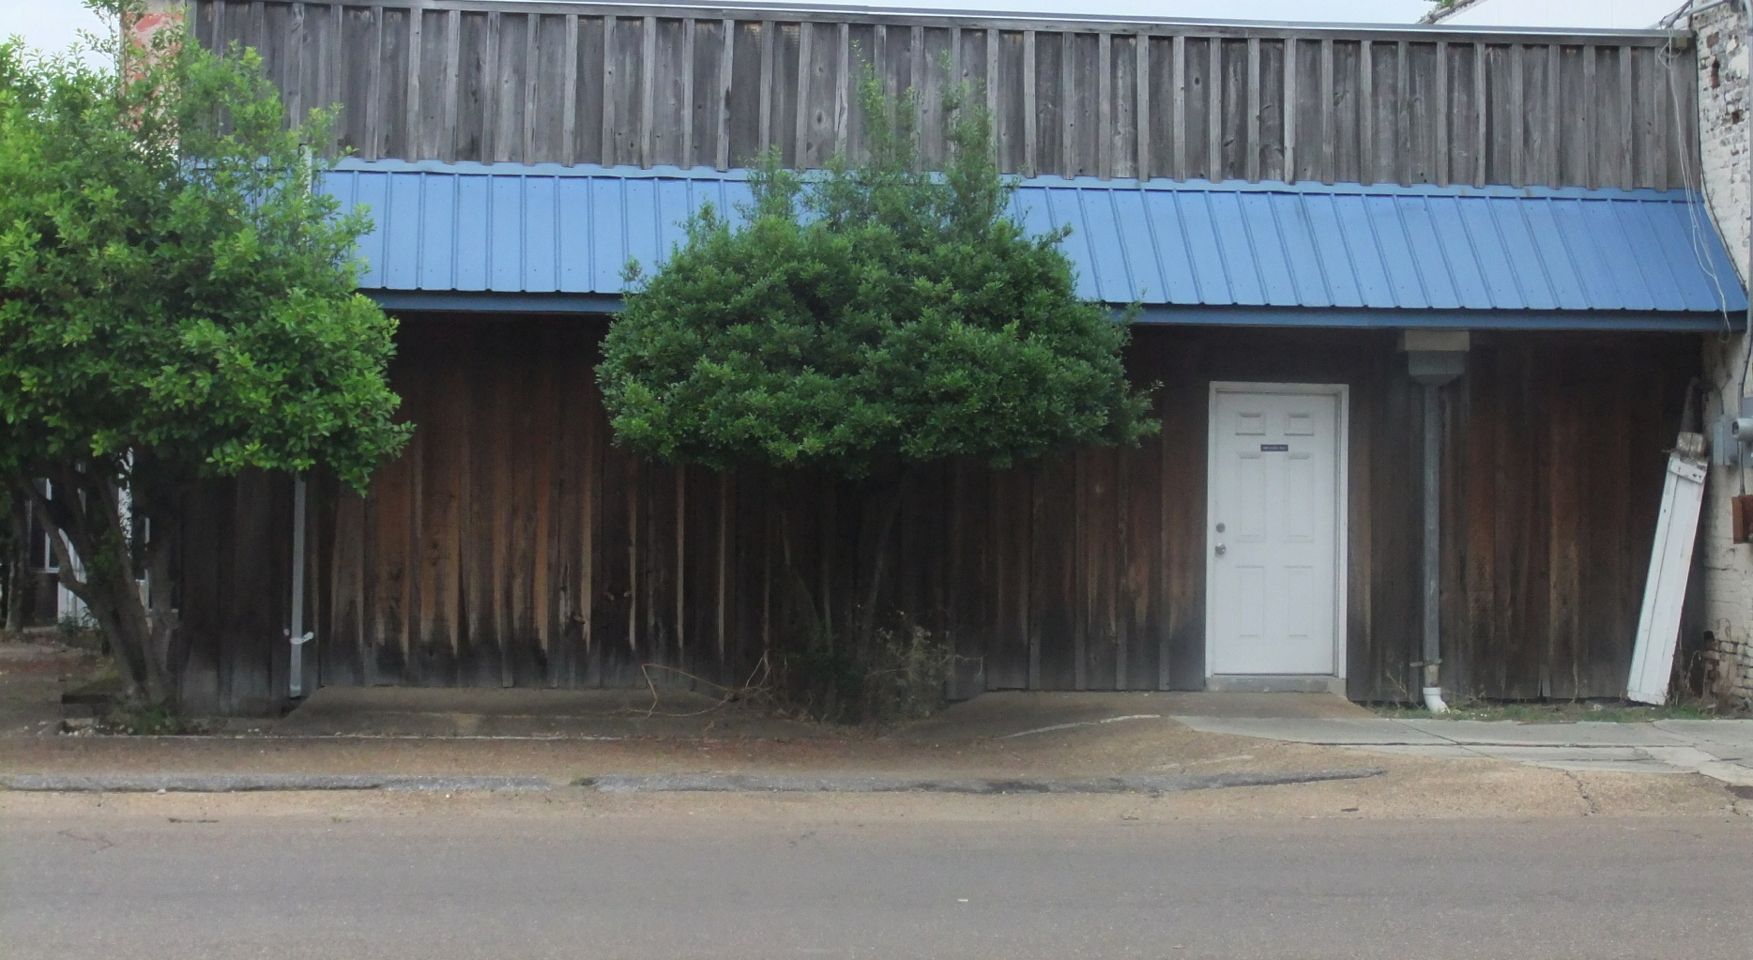
The Lives of Animals Haunt Elizabeth Costello.
As Clarksdale Mississippi haunts me.

Slide 13
But what is it for me to be haunted by Clarksdale Mississippi? What is it for her to be haunted by the Lives of Animals?
PERHAPS TO BE HAUNTED BY CLARKSDALE MISSISSIPPI IS TO BE FACED WITH A moral QUESTION ABOUT US AND THEM. A QUESTION ABOUT THEM-POOR/THEM-SOUTHERNERS/THEM-VICTIMS/THEM-DAMNED/THEM-BLACKS.
AND PERHAPS THE QUESTION IS:
WHAT WE SHOULD DO FOR THEM
HOW WE SHOULD UNDERSTAND THEM HOW WE SHOULD TREAT THEM
WHAT WE CAN LEARN FROM THEM
HOW WE SHOULD HELP THEM

Slide 14
In the first series of interpretations of this text
by a group of philosophers, sociologists and primatologists, the lectures were taken to concern the very same set of questions: the moral issue of how we humans should be treating them animals. And they were interpreted as giving fictionalized arguments for the extreme egalitarian view that we humans should be treating them animals as equals.
But Costello resists such a reading of her being haunted by the lives of animals:
“I was hoping not to have to enunciate principles [she says in clarification of her lectures]….If principles are what you want to take away from this talk, I would have to respond, open your heart and listen to what your heart says….I have never been much interested in proscriptions, dietary or otherwise. Proscriptions, laws. I am more interested in what lies behind them.” (p. 37)

Slide 15
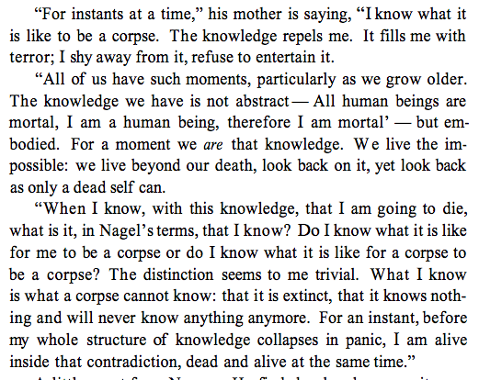
The knowledge that haunts Costello
Is not a knowledge of a moral truth in my profession: say a truth about how we x should treat them y.
The knowledge that haunts her she likens to the knowledge of death.

Slide 16
This knowledge Elizabeth Costello says we are capable of, but we resist.
We resist this way of knowing, Cora Diamond, a philosopher also writing on Coetzee’s lectures tells us, because of what she calls “the difficulty of reality”: the difficulty of understanding something that is both real and inconceivable that inflicts a wound on
To appreciate “the difficulty of reality”, Diamond tells us
“is to feel oneself being shouldered out of how one thinks, how one is apparently supposed to think, or to have a sense of the inability of thought to encompass what it is attempting to reach.” (p. 58)

Slide 17
On Diamond’s suggestion
We should understand Elizabeth Costello herself as the wounded animal, “the wounded woman, the woman with the haunted mind and the raw nerves” (Diamond p. 48). As “a branded, marked, wounded animal presenting himself as speaking testimony to a gathering of scholars.” (26)
And, Diamond continues,
“if we see in the lectures a wounded woman, one thing that wounds her is precisely the common and taken for granted mode of thought that ‘how we should treat animals’ is ‘an ethical issue’ and the knowledge that she will be taken to be contributing, or intending to contribute, to discussions of it.” (p. 51)

Slide 18
So that perhaps I am being haunted by Clarksdale Mississippi
Because I am FACING THE WOUND that I/WHITE/GREEK HAVE IN COMMON WITH THEM/BLACK SISTERS AND BROTHERS.
THAT I AM A BEING OF THE SOUTH ALSO.
THAT I AM A BEING OF THE VICTIMS OF RECURRENT FINANCIAL CRISES ALSO.
PERHAPS I AM NOT BLACK OR FROM THE AMERICAN SOUTH BUT
THAT I AM AM A BLACK FROM THE EUROPEAN SOUTH: I.E. A GREEK.

Slide 19
AND PERHAPS MY BEING HAUNTED BY CLARKSDALE MISSISSIPPI
IS A QUESTION OF US WOUNDED ANIMALS/US-VICTIMS OF THE CRISIS/US-GLOBAL SOUTHERNERS. AND PERHAPS THE QUESTION IS:
WHAT WOUNDS US? (THE ECONOMIC CRISIS?)
WHAT BREAKS US? (CAPITALISM?)
WHAT HEALS US? (LESS AUSTERITY?)
WHAT SAVES US? (OUR CENTER WING GOVERNMENTS?)

Slide 20
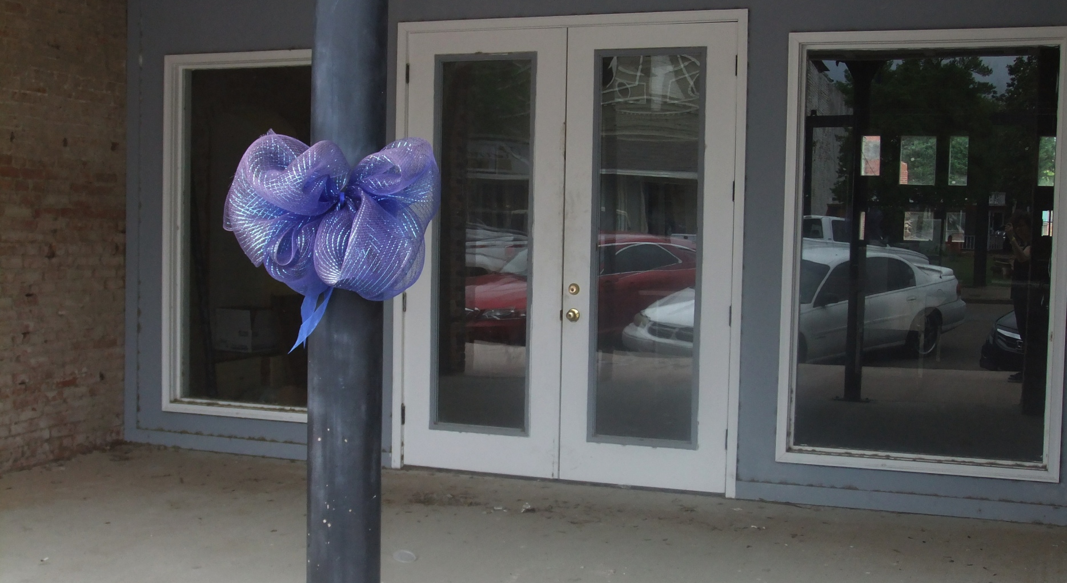
BUT CLARKSDALE HAUNTS ME STILL. COSTELLO HAUNTS ME STILL. HER WORDS DON’T LET ME REST IN PEACE.

Slide 22
MY THOUGHT IS TWISTING AND TURNING.
MY BEING HAUNTED BY CLARKSDALE MISSISSIPPI IS the dim, obscure, covered up and yet certain exercise of MY CAPACITY TO THINK that even though I am not burning today, even though I am not falling in ash today, even though I am not living in an immigrant camp in Greece today, even though I am not a black woman in the American south today, WHAT I SHOULD DO IS THINK: how would it be if I were burning today, how would it be if I were falling in ash today, how would it be if I were living in an immigrant camp in Greece today, how would it be if I were a black woman in the American south today, WHAT I SHOULD DO IS THINK: I am burning today, I am falling in ash today, I am living in an immigrant camp in Greece today, I am a black woman in the American South today.
My being haunted by Clarksdale Mississippi is my dim, obscure and covered up exercise of our capacity to think ourselves into the being of another.
But this, our capacity to think ourselves into the being of another is not the province of a special feeling: say that of sympathy. This, our capacity to think ourselves into the being of another is the distinctive mark of human thought itself: one instance of which I take philosophy to be.

Slide 23
THE CAPACITY TO THINK OURSELVES INTO THE BEING OF ANOTHER.
This is the kind of thought the Germans and the Poles around the NAZI concentration camps resisted. They said “it must be the dead stinking”.
This is the kind of thought we Greeks and Europeans around the immigrant concentration camps resist. We say “it must be the immigrants being washed off the shores of the Greek islands”.
This is the kind of thought that the northern Europeans around the southern Europeans resist. You say “It must be the Greeks losing their way of life”.
This is the kind of thought that we animal eaters resist. We say “It must be the animal slaughterhouse smelling today”.

Slide 24
This is the kind of thought the Humanities – the Sciences of the Spirit - were meant to help us understand, develop and exercise but now help hide and obscure by establishing *the relocation* where we should have been asking what it is to be forced to live out of your living environment, by establishing *the abolition of slavery* where we should have been asking what it is to live like a slave without being a slave, by establishing *the crisis* where we should have been asking what it is to live through the end of one’s a way of life, by establishing *the refugee crisis* where we should have been asking what it is for a living body to live the life of confinement.
This is the question professional philosophy also covers up by asking the question of being in abstraction from the questions of our times. By asking, that is, the question of reality, mind and duty in abstraction from the questions of our life.

Slide 25
To engage in this kind of thought is to do what we humans do. This thought is natural for us humans.
I see your crying and I feel your pain.
I hear your words and I think your thoughts.
I witness your actions and I witness your intentions.
It is our nature but second nature, because we, unlike many other living beings have to learn to do so. Learn not just by instruction but through the way more complicated notion of Bildung, of the formation of character that comes as a result of being habituated properly into a way of life that fosters the growth of this capacity. This kind of thought is what we can do best if properly habituated.

Slide 26
When we talk about the relocation of the Indian Nations we resist this thought. When we talk about the Greek crisis we resist this thought. When we talk about the refuge crisis we resist this thought. We resist this thought because of the difficulty of reality. Because to engage in it would be to be shouldered out of the way we think and eventually out of the way we live.
But to resist this thought does not come naturally: it is to force ourselves and be forced to not do what we humans do: think ourselves into the being of another.
This force is what dehumanizes us.
And to the extent that the humanities institutionally exert this force, to this extent the humanities institutionally dehumanize us.

